Slide 1

Credit Card Fraud Detection Machine Learning Model
Kunwar Urjaswit
Hanumant Garad
Shreyas S.

Slide 2
Agenda
Introduction
Background
Problem Statement
Objective
Data Insights
Model Evaluation and Conclusion
Cost Benefit Analysis
Business Recommendation
Appendix
Data Attributes
Solution Methodology
Models

Slide 3
Introduction
Credit card fraud is an inclusive term for fraud that is committed using a payment card, such as a credit card or a debit card, by stealing the card information through skimmers
The Federal Trade Commission (US) estimates that 10 million people become victims of credit card theft each year
Credit card companies lose close to $50 billion dollars per year to fraud

Slide 4
Background
Finex is a leading financial service provider based out of Florida, US. It offers a wide range of products and business services to customers through different channels, ranging from in-person banking and ATMs to online banking.
Over the last few years, Finex has observed that a significantly large number of unauthorized transactions are being made, due to which the bank has been facing a huge revenue and profitability crisis.

Slide 5
Problem Statement
In the banking industry, detecting credit card fraud using machine learning is not just a trend; it is a necessity for banks.
They need to put proactive monitoring and fraud prevention mechanisms in place.
Machine learning helps these institutions reduce time-consuming manual reviews, costly chargebacks and fees, and denial of legitimate transactions.

Slide 6
Objective
For banking companies like Finex, retaining high profitable customers is the most important business goal. With the rise in digital payment channels, banking fraud, however, poses a significant threat to this goal for many banks.
As a part of Data Science capstone project, our task is to identify the root cause of this issue of unauthorized transactions on credit card and recommend ways to mitigate this problem
Build a machine learning model to detect fraudulent transactions based on the historical transactional data of customers

Slide 7
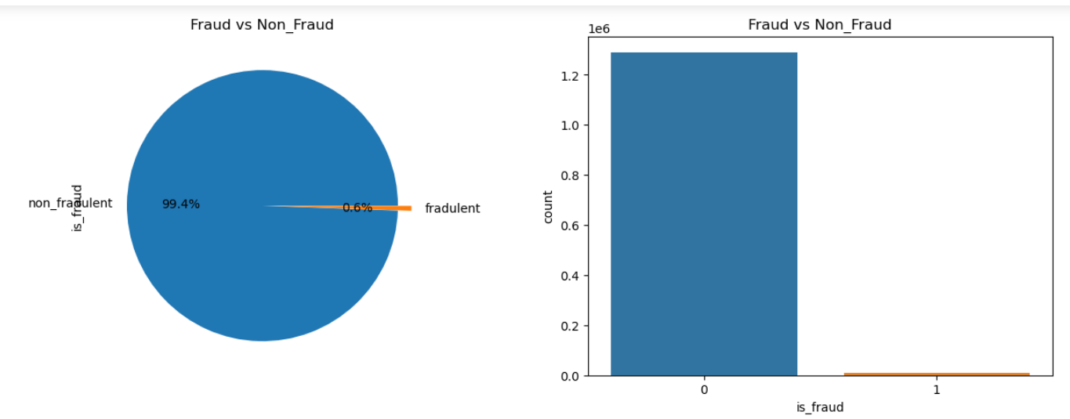
Data Insights
Class Imbalance
Fraud data = 0.6%
Non-Fraud data = 99.4%
Data Imbalance ratio = 171.75%

Slide 8
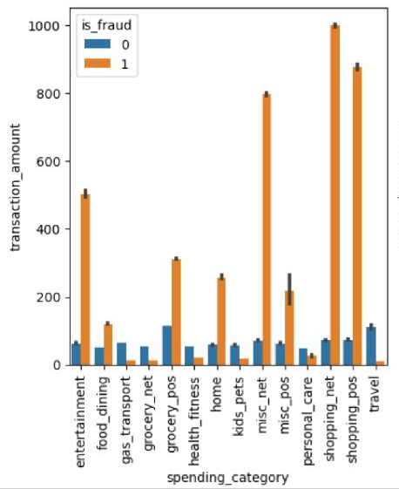
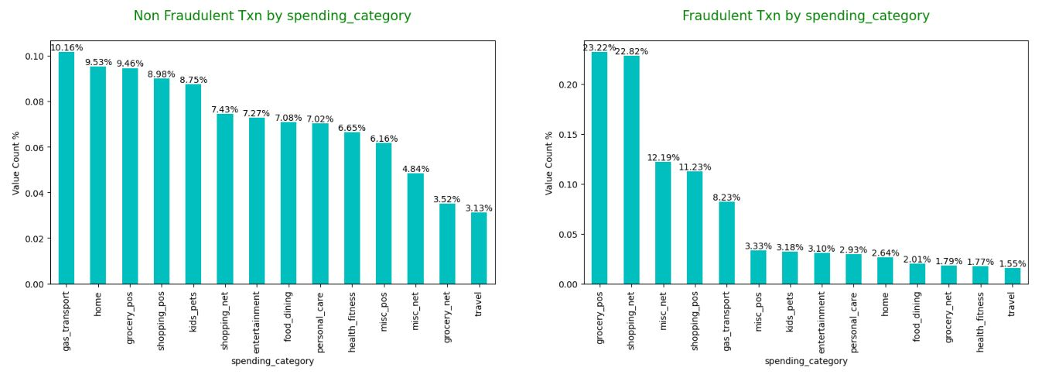
Fraud vs Non-Fraud Transactions per spending category
Spending categories such as grocery_pos, shopping_net, misc_net and shopping_pos seems indicative for fraudulent transactions and that shows high fraudulent amount as well

Slide 9
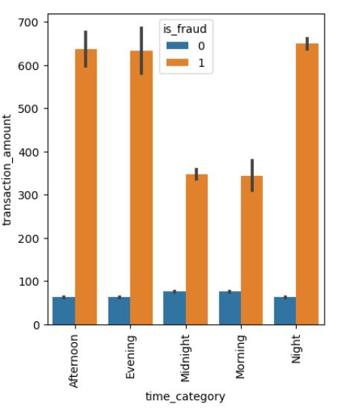
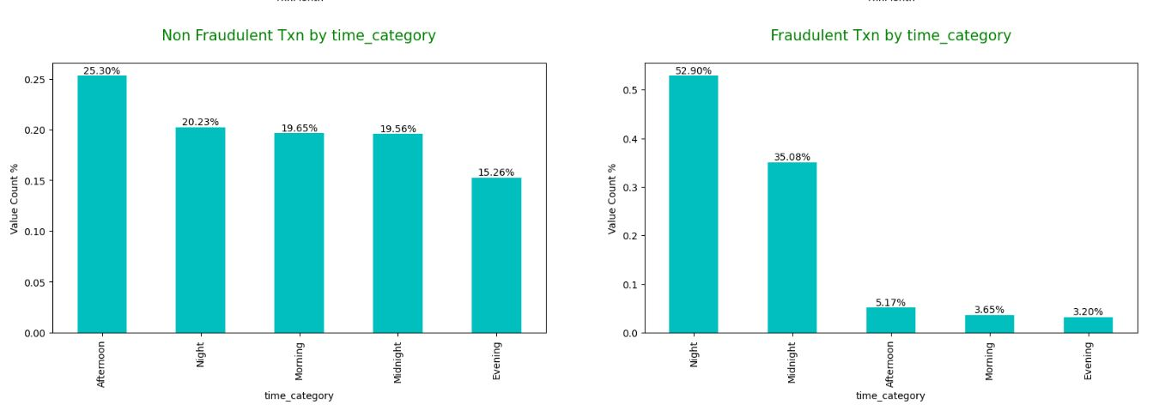
Fraud vs Non-Fraud Transactions per time category
Nights and Midnights are highly prone to fraud while non fraudulent transactions happens more in afternoon.
An amount of fraudulent transactions done in the nights is high comparatively.

Slide 10
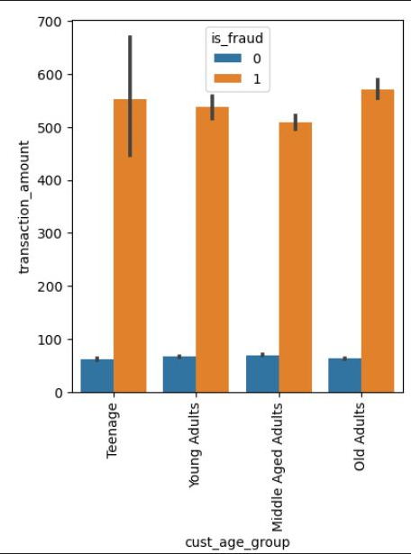
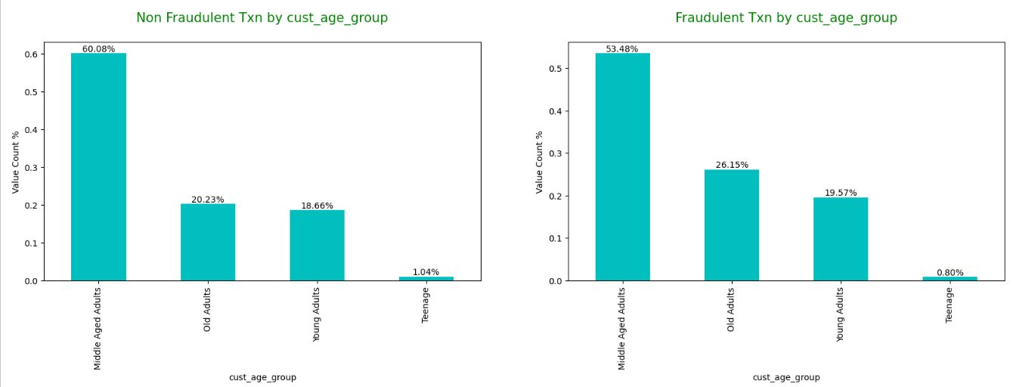
Fraud vs Non-Fraud Transactions per customer age
Old adults are more sensitive to frauds compare to other age groups and contributing to high fraud transaction amount

Slide 11
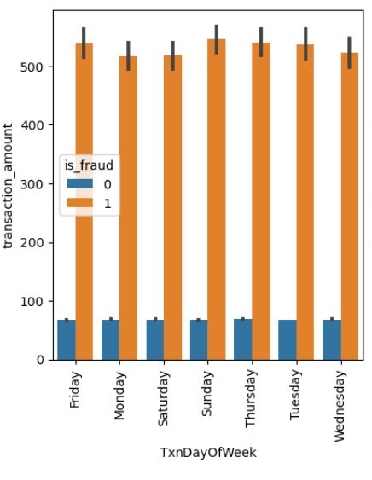
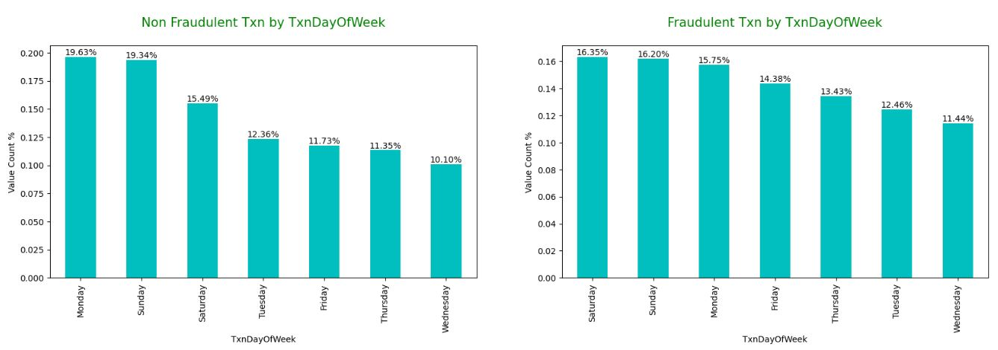
Fraud vs Non-Fraud Transactions per day of week
Non fraudulent transactions tend to happen more often on Monday whereas fraudulent transactions happens more on Saturday however surprisingly the amount of fraud transactions is less compared to other days of week

Slide 12
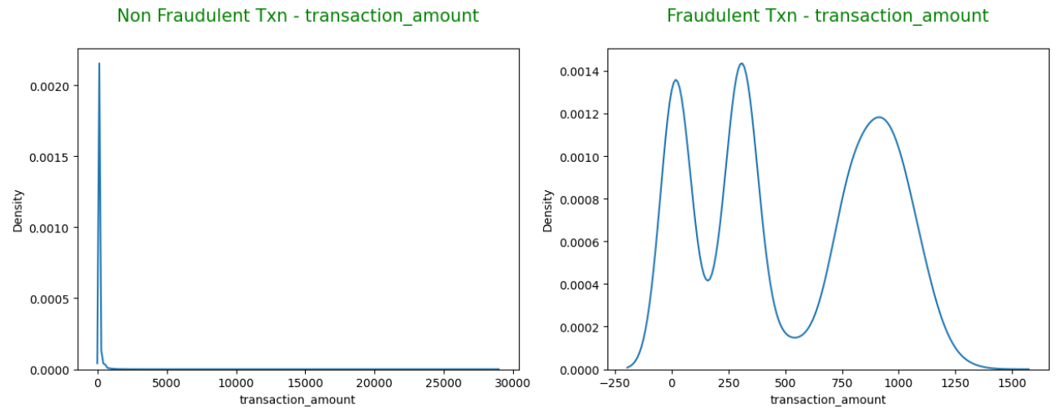
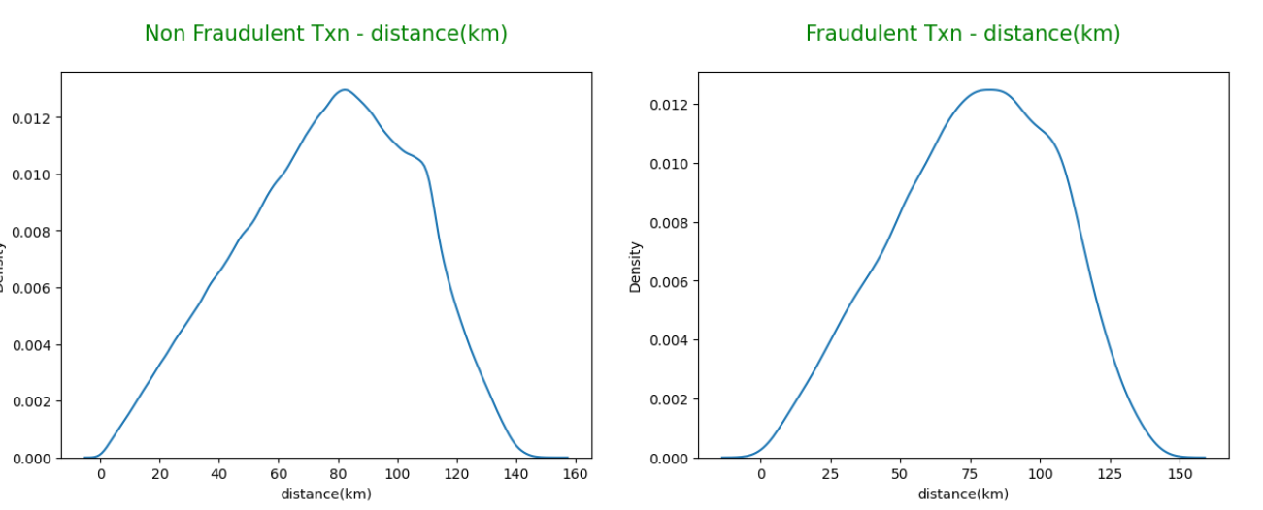
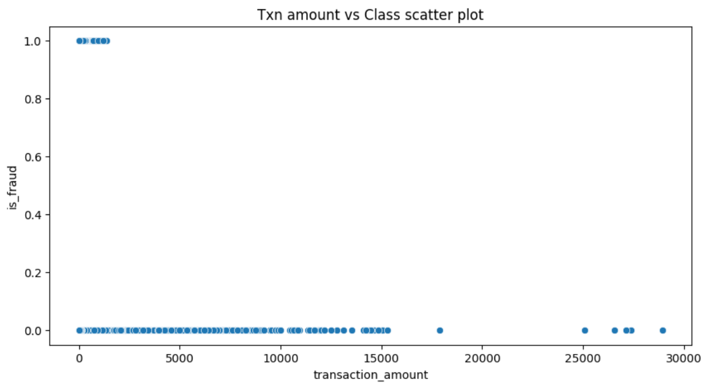
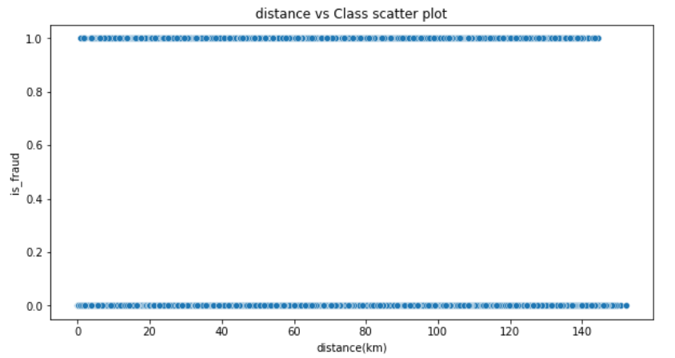
Distribution of transaction amount and distance over fraud and non-fraud
Surprisingly, fraudulent transaction amount is lower compared to non fraudulent transaction amount and distance between customer base and merchant does not have any implications on fraudulent transactions.

Slide 13
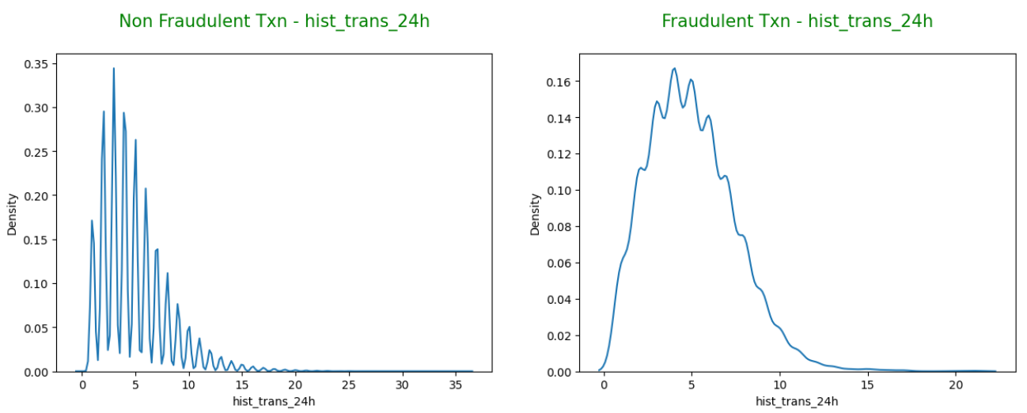
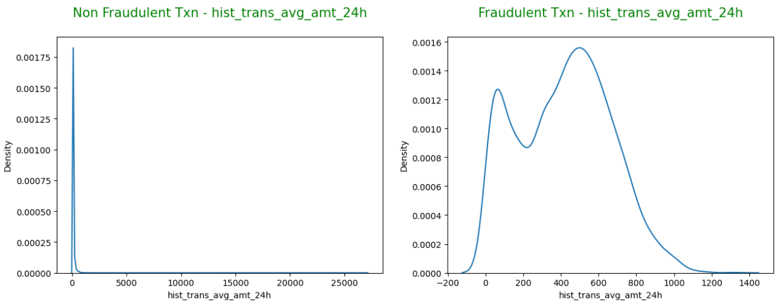
Distribution of historical transaction count and amount over fraud and non-fraud
Last 24 hours rolling fraudulent transactions and its amount is well spread and that shows consistent and stable pattern of fraudulent transaction activity.

Slide 14
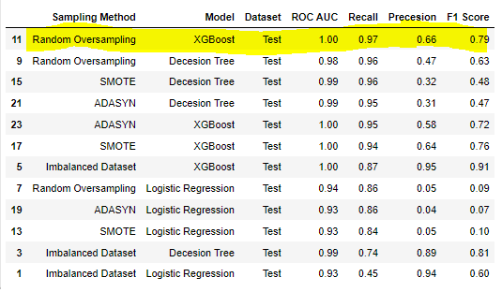
Model Evaluation

Slide 15
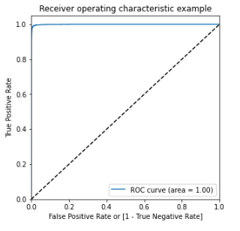
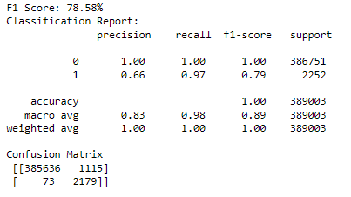
Model Evaluation Test data – XGBoost (Random Oversampling)
F1 Score and Classification Report
ROC AUC curve

Slide 16
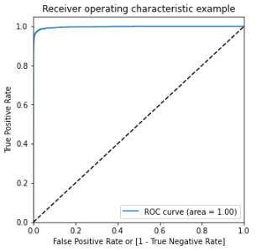
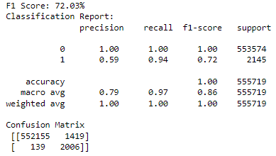
Model Evaluation Unseen data– XGBoost (Random Oversampling)
F1 score and classification report
ROC AUC curve

Slide 17
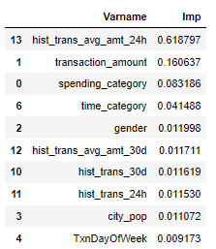
Feature Importance – XGBoost (Random Oversampling)

Slide 18
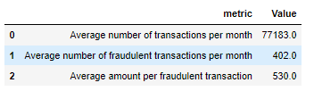
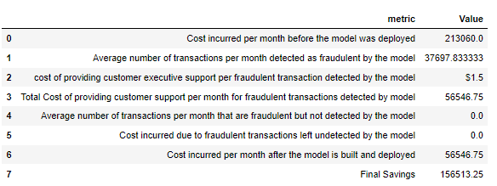
Cost Benefit Analysis
Part 1: Analysis before model deployed
Part 2: Analysis after model deployed

Slide 19
Business Recommendation
The bank should send a SMS alert to customer if the transaction debit amount is more than average amount of transaction in the past 24 hours.
The probability of fraudulent transaction is more on Thursday, Saturday and Monday so banks need to be more vigilant on these days.
The fraudulent transaction probability of a customer increases with increase in `amt` values. At any point in time if bank notices the amount spent is higher than regular spending pattern in such cases bank should send alerts to customers.
The fraudulent transaction probability of a customer increases with increase in spending under following categories grocery_pos, shopping_net, misc_net and shopping_pos . In such case its always recommended to bank to keep an eye on the track record of spend amount through FLASH SMS ALERT mentioning the detailed transaction history to respective credit card holders.
The fraud transactions are majorly done during Night and Midnight of the day, so banks needs to send an SMS ALERT during such odd hours.

Slide 20
Appendix: Solution Methodology
Build a machine learning model to predict the fraudulent transactions using a simulated credit card transactional Kaggle data set as a proof of concept
Data Preparation
Data Reading: After reading data, following basic data quality aspects were investigated:
Dimension of dataset, datatypes, null values, duplicate values, number of unique values
Data Cleaning:
Removed unnecessary and irrelevant features like customer demographic variables.
object data type changed to category to reduce memory usage and datetime for deriving time intelligent features
couple of features renamed for easy understanding
Data Reading
Data Cleaning
Feature Engineering
Data Preparation
Model Building
Model Evaluation
Performing EDA

Slide 21
Feature Engineering:
Derived transaction historical features to help raising fraud alarm
Derived time intelligence features to understand fraud seasonality
Derived distance between customer base and merchant where card is swiped assuming more distance lead fraudulent transaction
States are grouped based on geographical regions to reduce dimensions of the dataset
EDA:
Understand class imbalance
Univariate Analysis
Bivariate Analysis

Slide 22
Data Preparation:
Label Encoding: It is for converting categorical data into numerical levels and to reduce the dimensionality of the feature space since there are few variables having large number of distinct categories.
Stratified Train – Test split: It is to ensure that the target variable's class proportions are preserved in the train and test datasets
Feature scaling: Though tree-based algorithms such as decision tree and random forest not sensitive to feature scale, it is necessary for gradient based optimization algorithms such as XGBoost to converge fast so it is performed across all model to maintain consistency.
Model Building:
Build following models on imbalanced dataset and dataset with oversampled minority class using Random Oversampling, SMOTE, and ADASYN methods
Logistic Regression
Decision Tree
XGBoost
Stratified k-fold cross validation technique is used to ensure representative and unbiased evaluation of the model performance.
Hyperparameter tuning and selection of best hyperparameters done using grid search technique

Slide 23
Model Evaluation
All the models are evaluated using 3-folds and 5-folds and the results of the both the ‘k’ were same hence 3-folds are finalized by knowing the fact of limitations in computational resources and time.
Following evaluation metrics were used:
AUC
Recall
Precession
F1 score
Final model XGBoost using Random oversampling method is selected based on Recall metric as our business objective is to identify fraud transactions accurately than the non fraud transactions.
Final model XGBoost using Random oversampling method is also evaluated on unseen data

Slide 24
Thank you!

